Slide 1

DATS 6102 Final Project
Team Members:
Brian
Fathima
Joseph
Sudip
Varsha
‹#›

Slide 2
Global Terrorism Project
Overview:
Conceptual Model
ER Diagram (Fact,Dimensions and Mapping tables)
Dimensional Model
Data Analysis & Score Card
ETL Process
Data Warehouse Database
Visualizations
‹#›
Notes:
We performed data quality assessment in sales data. In this presentation we are going to discuss about our initial analysis results, action taken and recommendation to apply data cleansing processes and to prevent data quality issues.

Slide 3
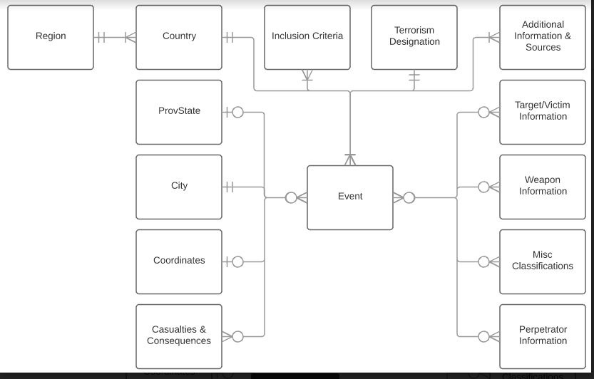
Global Terrorism Project - Conceptual Model
‹#›

Slide 4
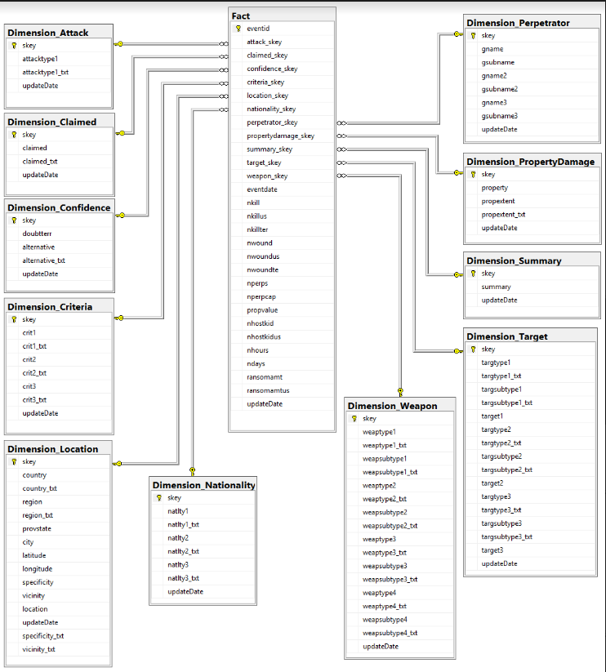
ER Diagram with Fact and Dimension tables
‹#›

Slide 5
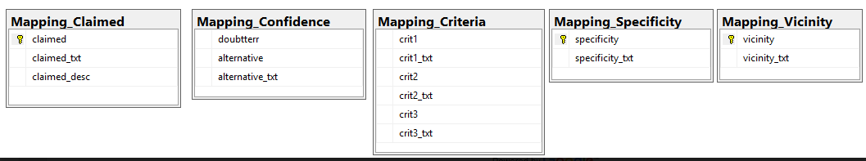
ER Diagram (Mapping tables only)
‹#›

Slide 6
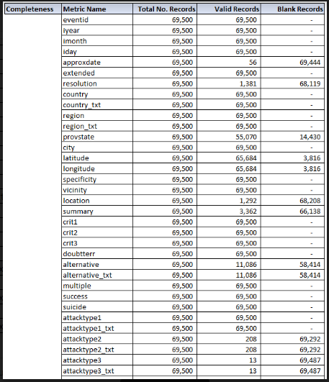
Data Analysis - Completeness
‹#›

Slide 7
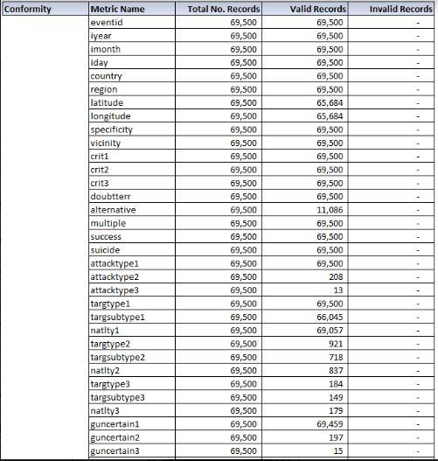
Data Analysis - Conformity
‹#›

Slide 8
Data Analysis - Uniqueness
‹#›

Slide 9
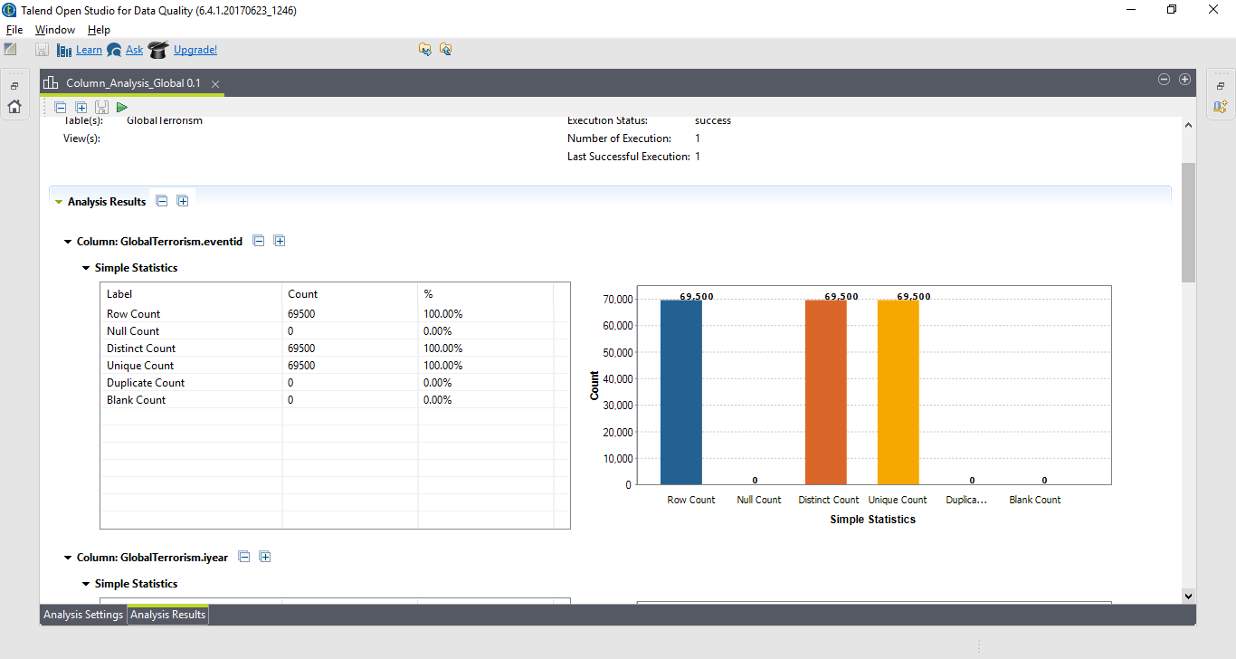
Data Quality for completeness
‹#›

Slide 10
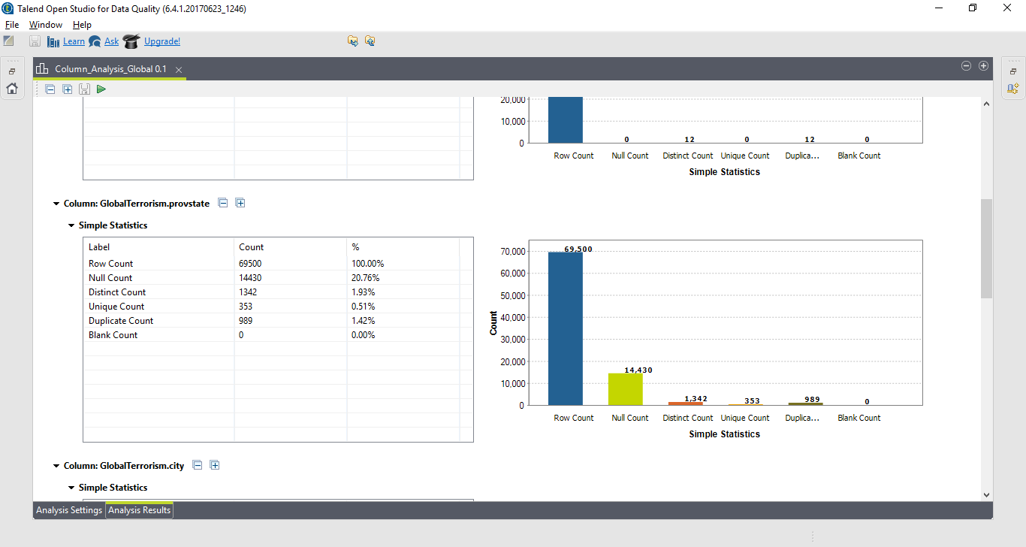
DQ-completeness-Provstate

Slide 11
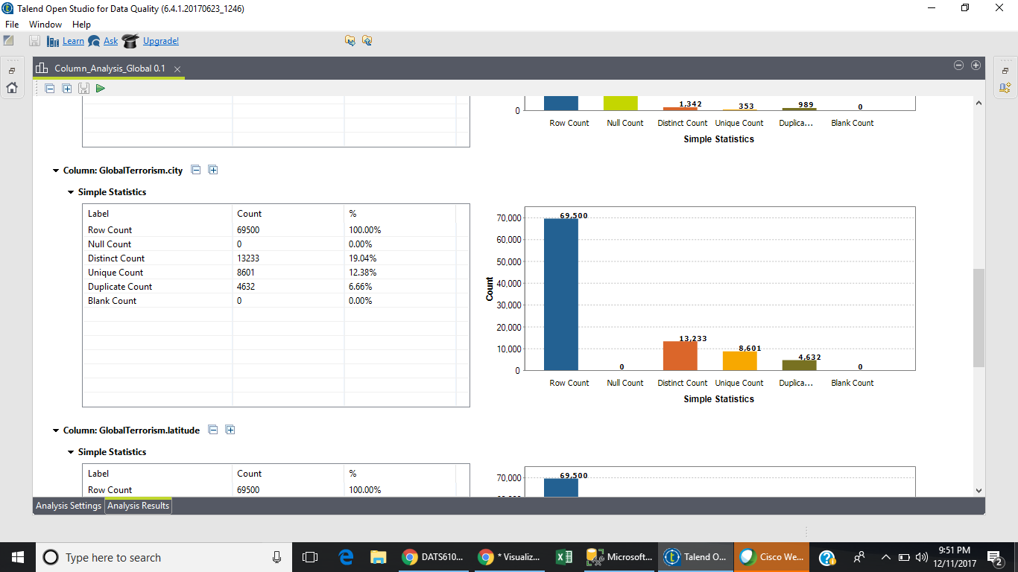
DQ-completeness- City

Slide 12
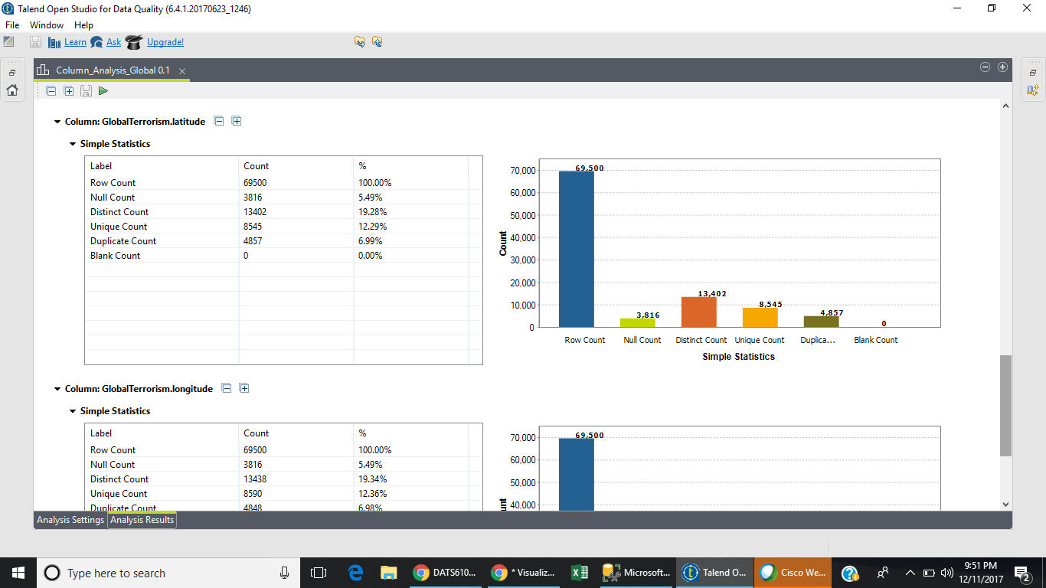
DQ- completeness-Latitude

Slide 13
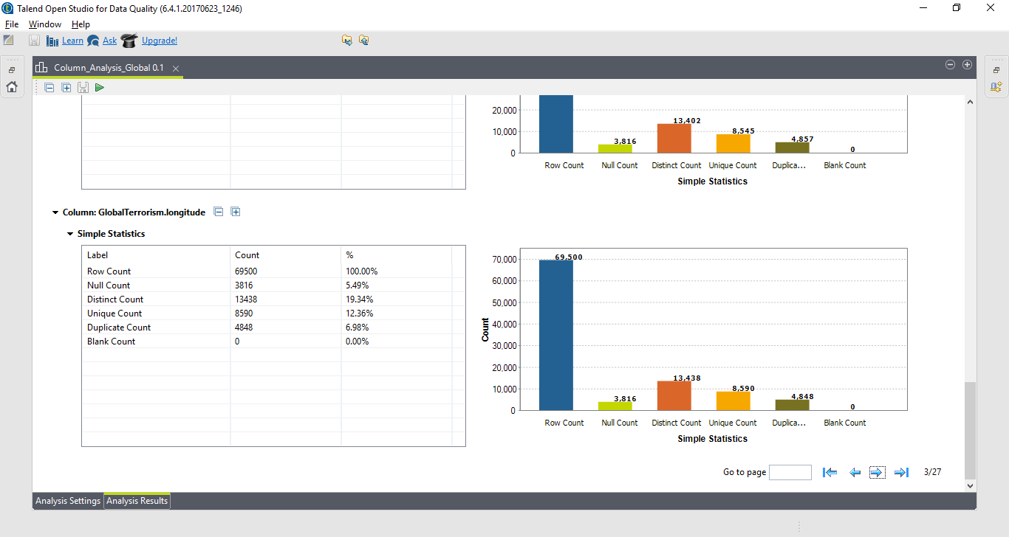
DQ- completeness-Longitude

Slide 14
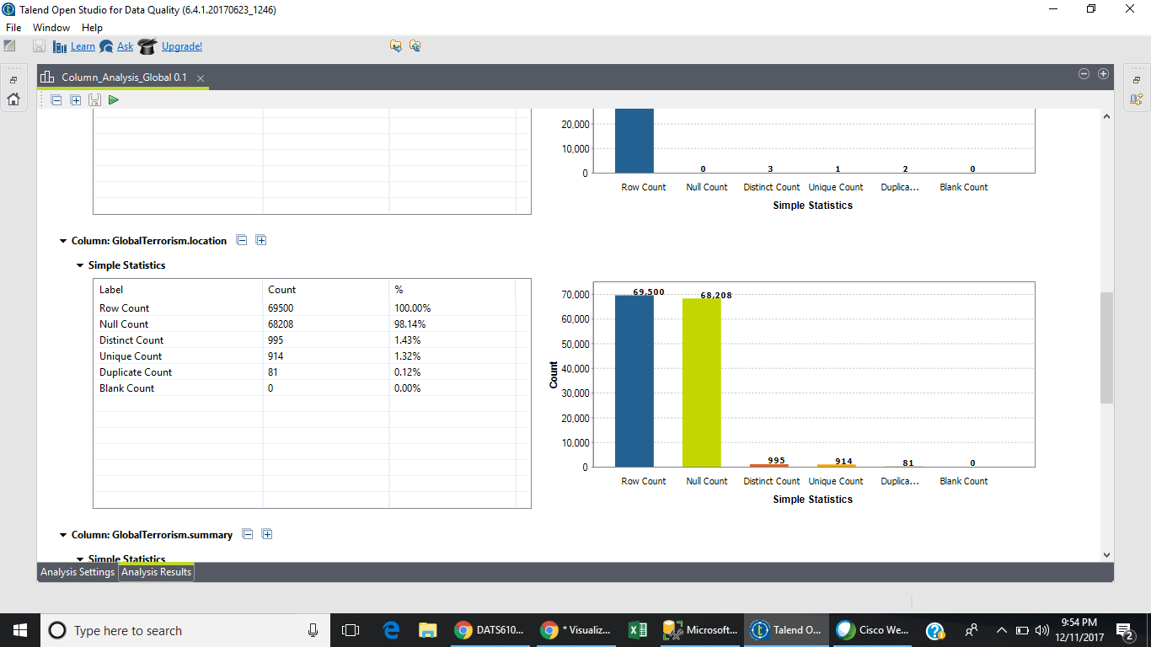
DQ- completeness -Location

Slide 15
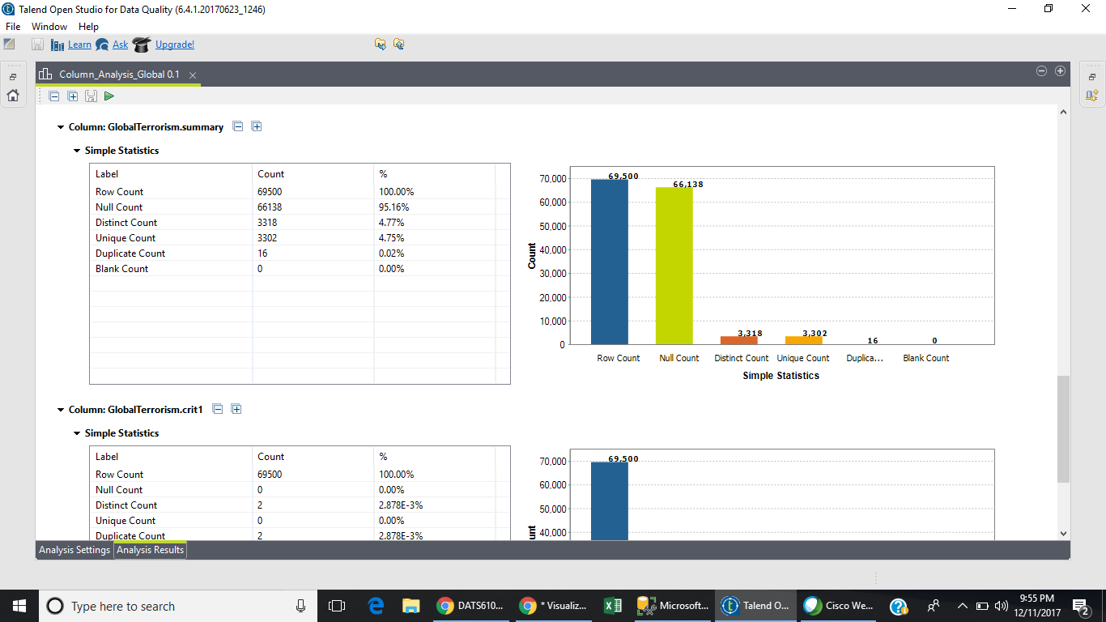
DQ- completeness - Summary

Slide 16
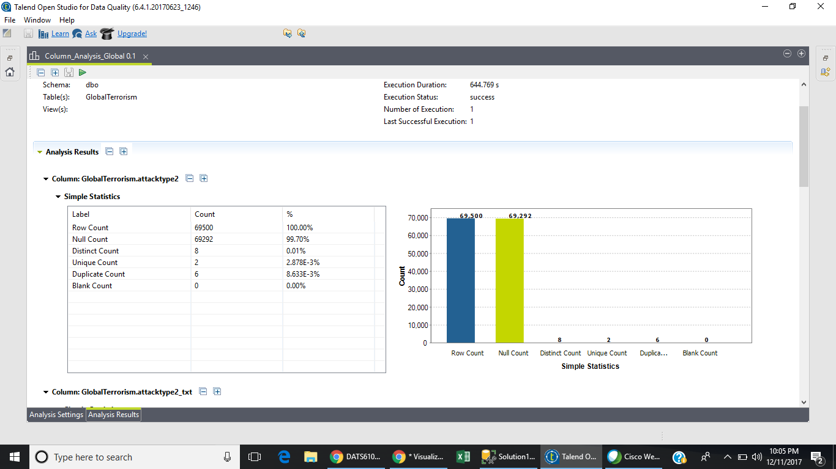
DQ completeness -AttackType2

Slide 17
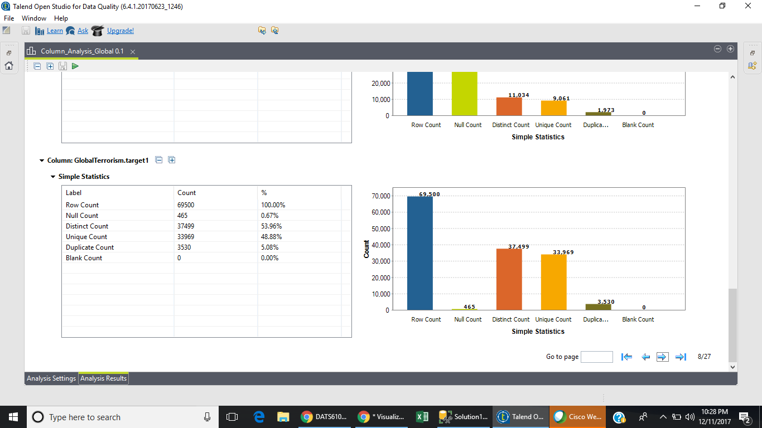
DQ-completeness Target1

Slide 18
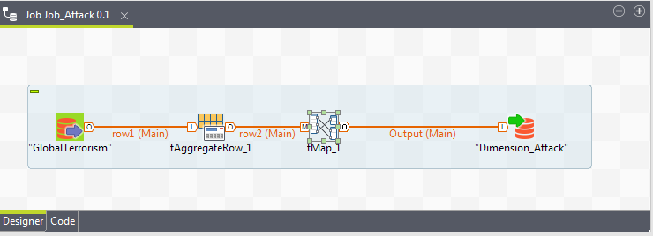
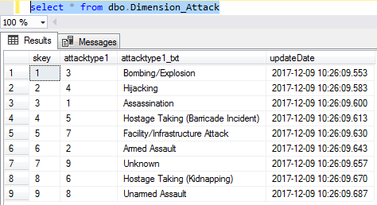
Dimension Name: Attack
‹#›

Slide 19
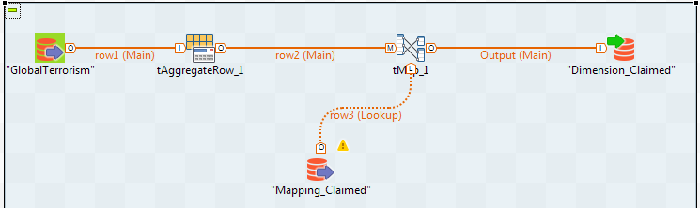
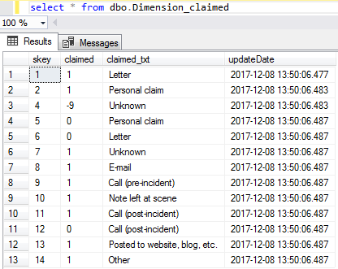
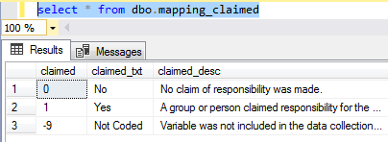
Dimension Name: Claimed
‹#›
Notes:
"Mapping_Claimed". Has the textual descriptions of each value.

Slide 20
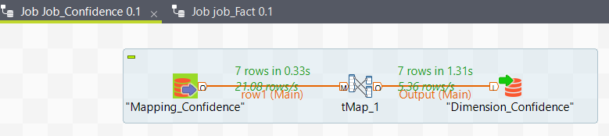
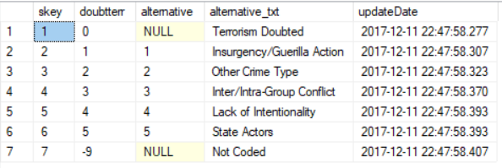
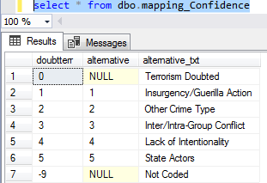
Dimension Name: Confidence
‹#›
Notes:
"Mapping_Claimed". Has the textual descriptions of each value.

Slide 21
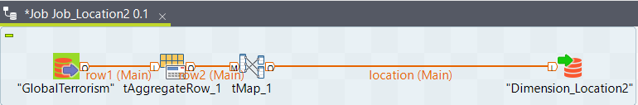
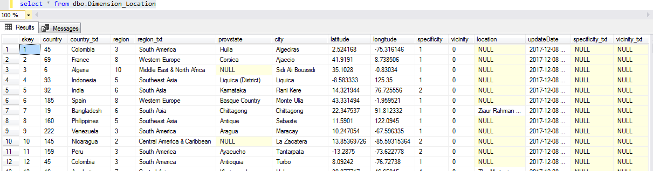
Dimension Name: Location
‹#›
Notes:
lookup the Specificity and Vicinity values in the corresponding mapping tables to find their textual representation.

Slide 22
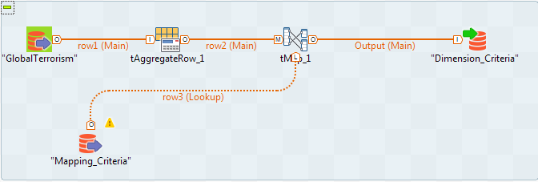
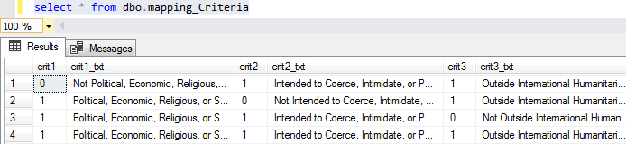
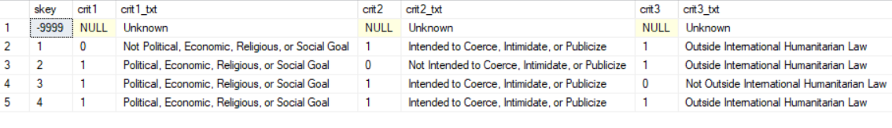
Dimension Name: Criteria
‹#›
Notes:
"Mapping_Claimed". Has the textual descriptions of each value.

Slide 23
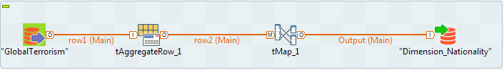
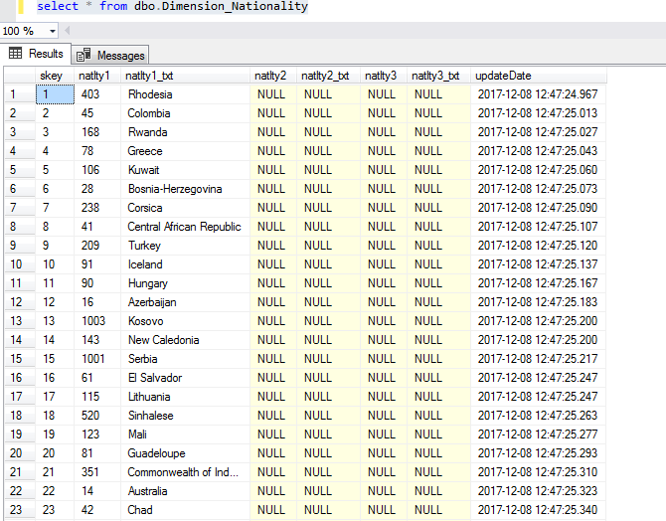
Dimension Name: Nationality
‹#›
Notes:
"Mapping_Claimed". Has the textual descriptions of each value.

Slide 24
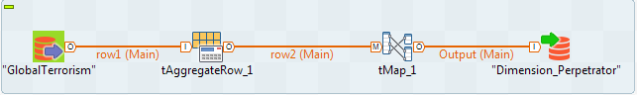
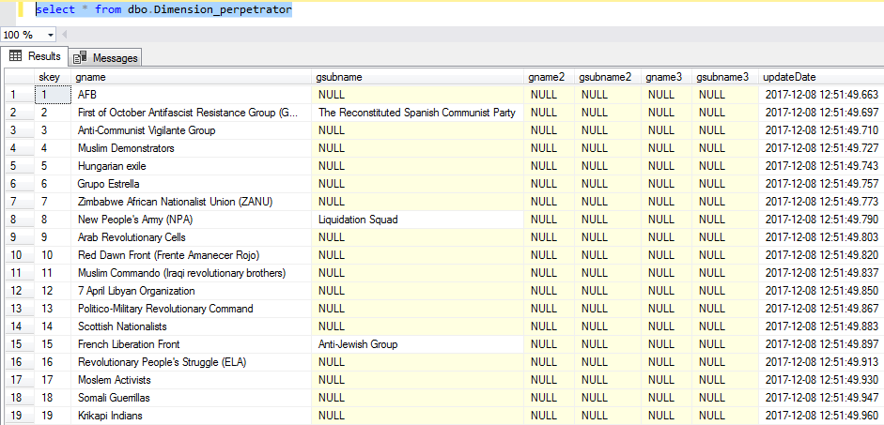
Dimension Name: Perpetrator
‹#›
Notes:
"Mapping_Claimed". Has the textual descriptions of each value.

Slide 25
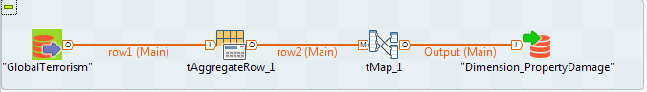
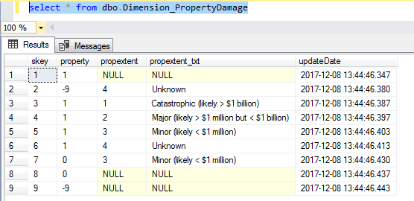
Dimension Name: Property Damage
‹#›
Notes:
"Mapping_Claimed". Has the textual descriptions of each value.

Slide 26
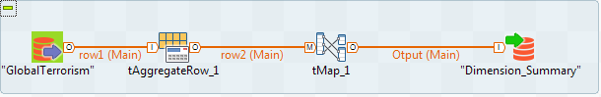
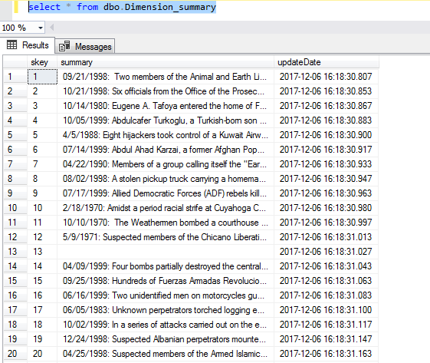
Dimension Name: Summary
‹#›
Notes:
"Mapping_Claimed". Has the textual descriptions of each value.

Slide 27
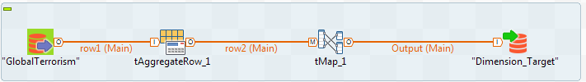
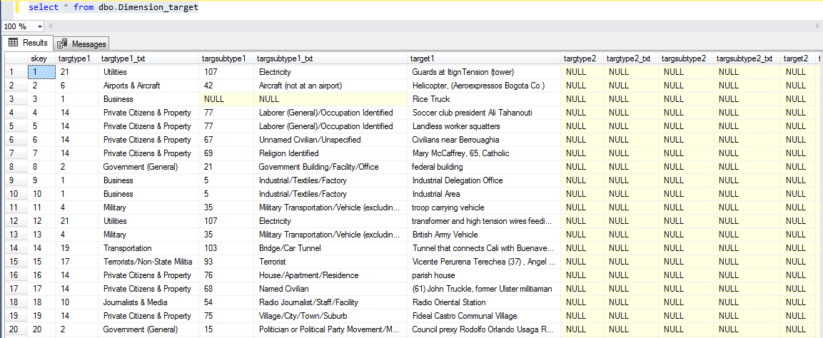
Dimension Name: Target
‹#›
Notes:
"Mapping_Claimed". Has the textual descriptions of each value.

Slide 28
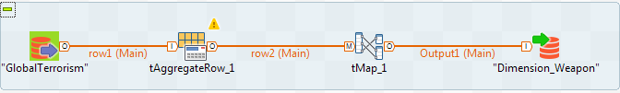
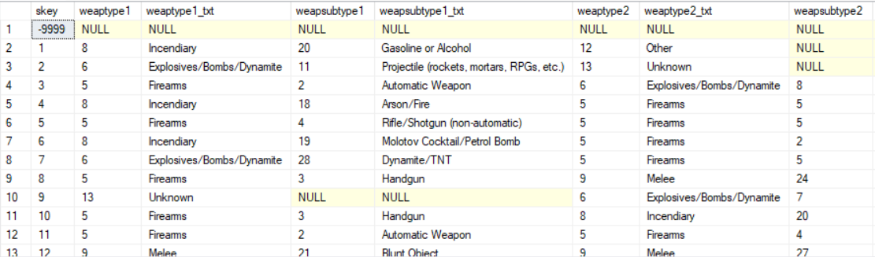
Dimension Name: Weapon
‹#›
Notes:
"Mapping_Claimed". Has the textual descriptions of each value.

Slide 29
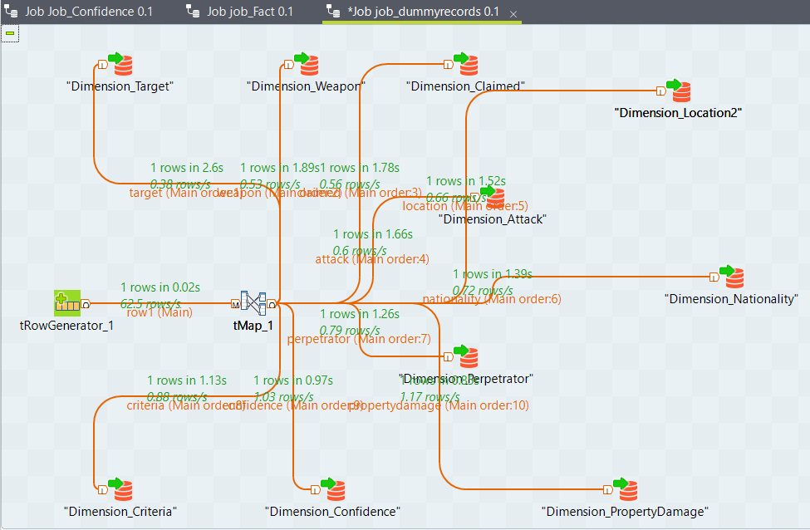
Dummy Record Dimension Job

Slide 30
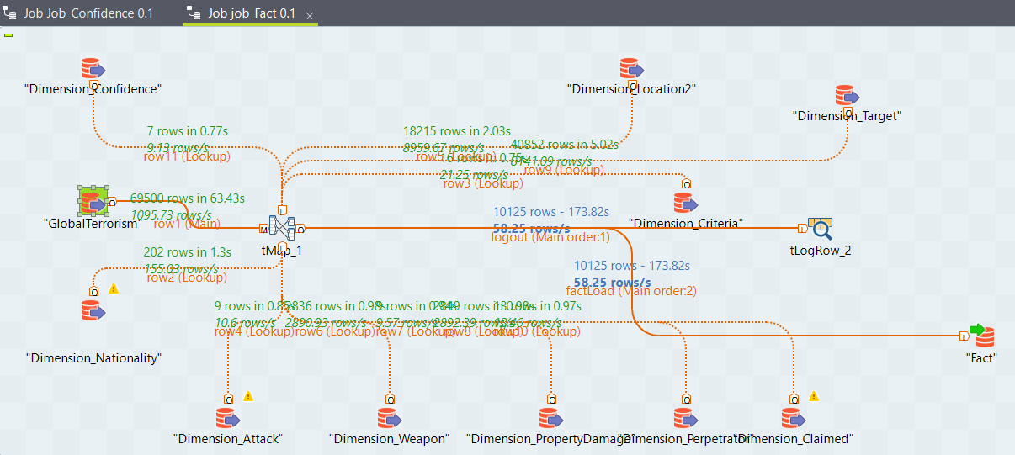
Fact Load Job

Slide 31
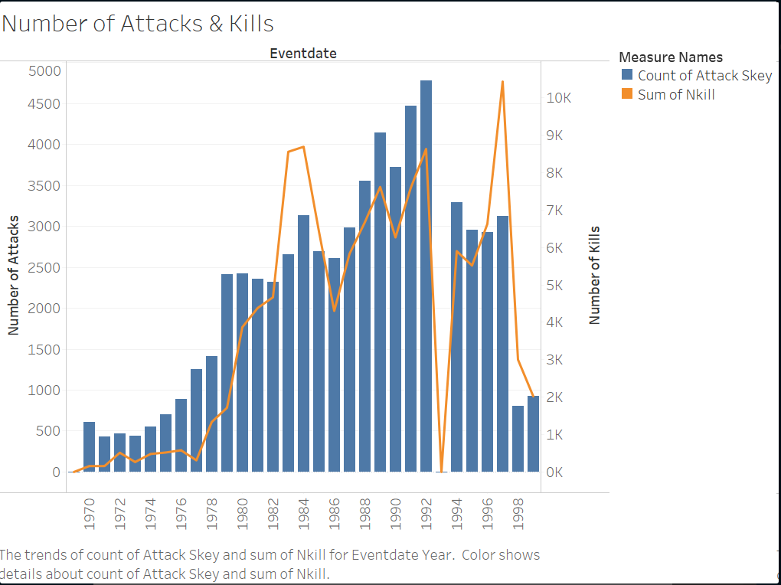
Number of Attacks and Kills
‹#›

Slide 32
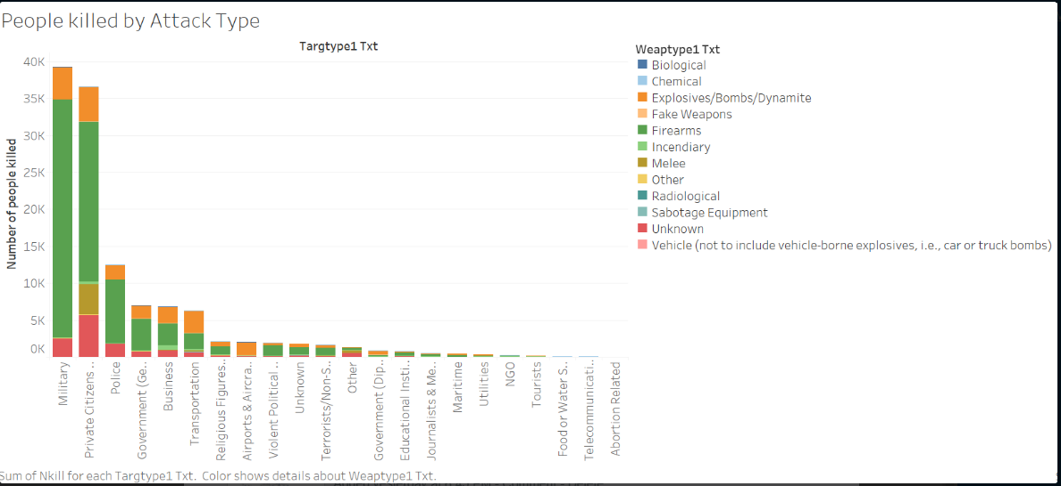
People killed by Attack Type
‹#›

Slide 33
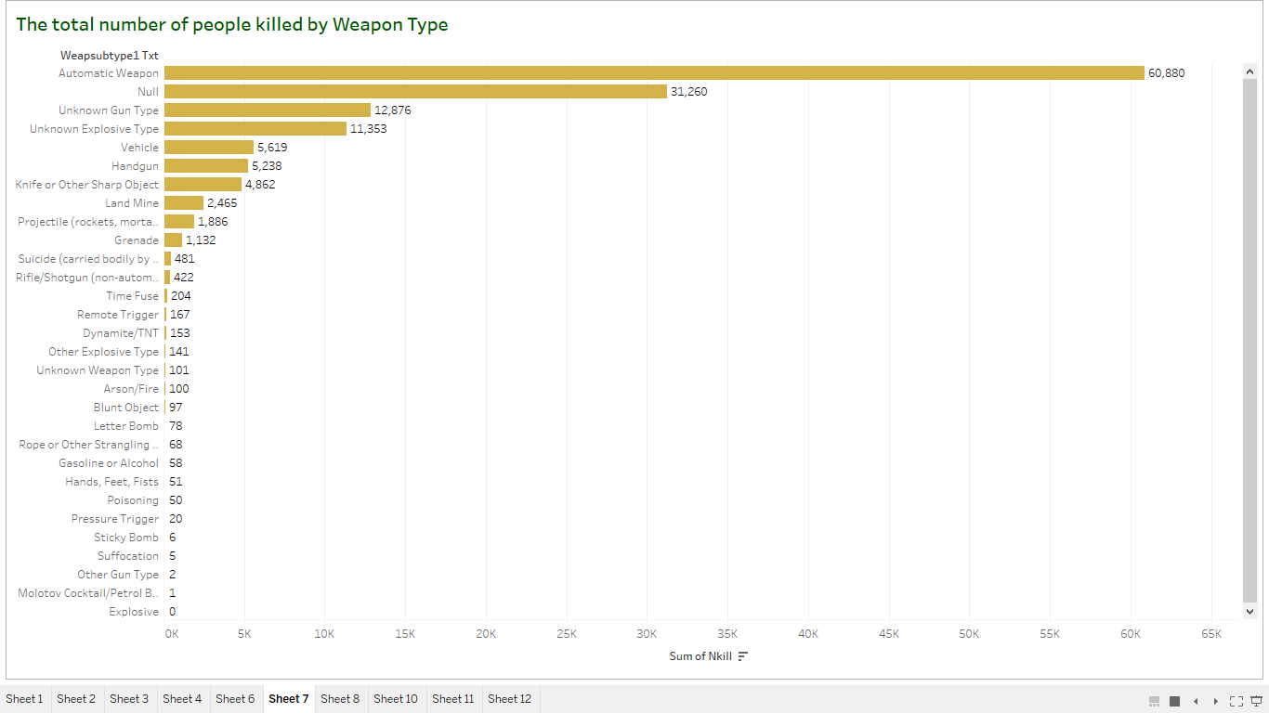
Total number of people killed by Weapon Type
‹#›

Slide 34
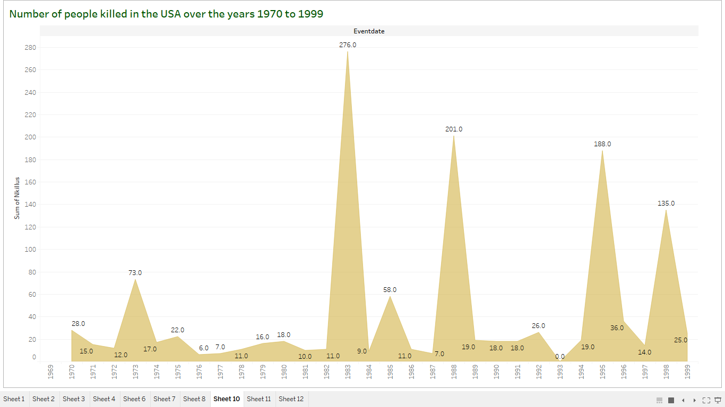
Number of people killed in USA

Slide 35
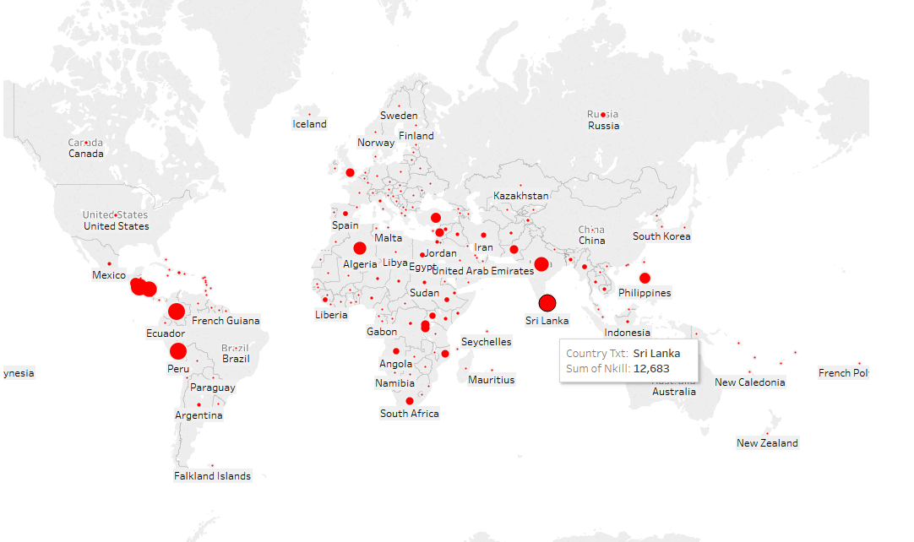
Distribution of Fatalities across the Globe
‹#›

Slide 36
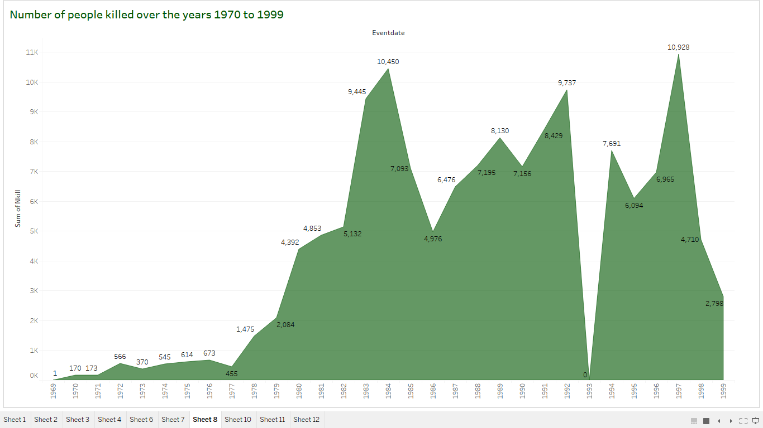
Number of people killed over years

Slide 37
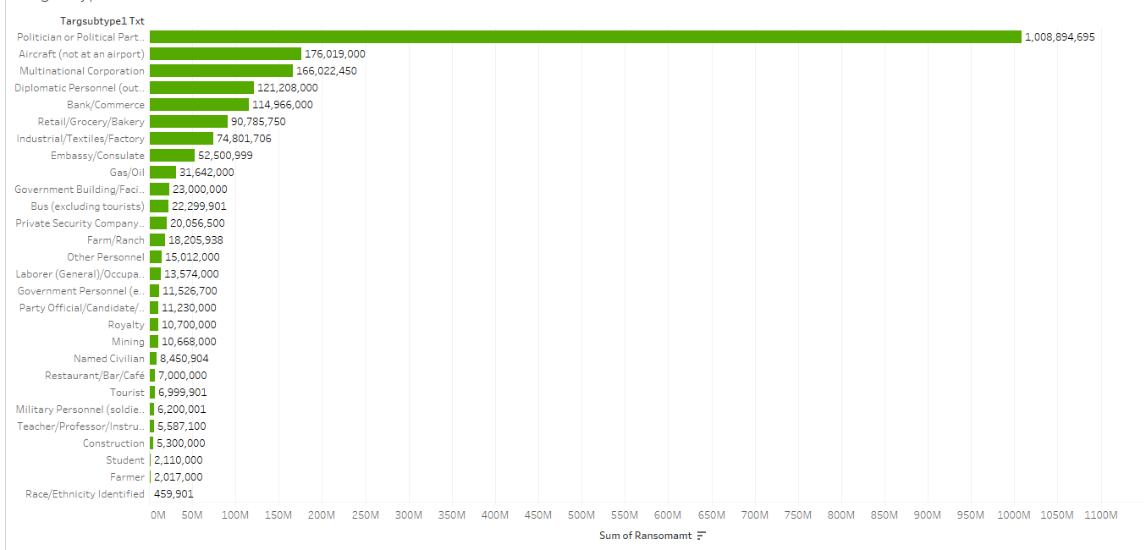
Amount of ransom based on target type

Slide 38
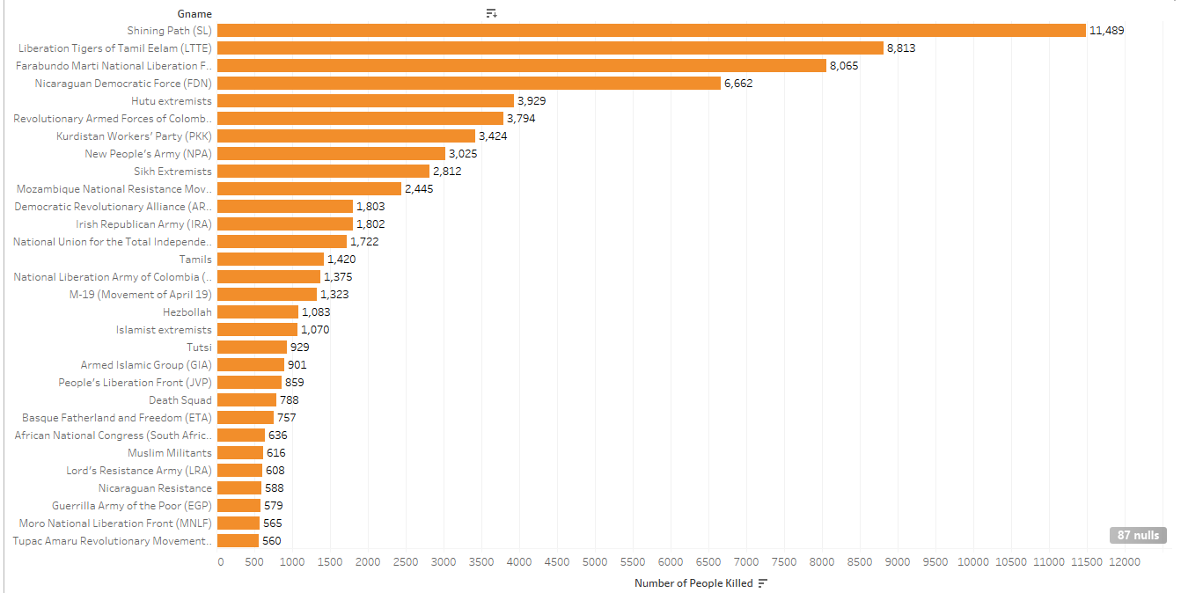
Fatalities caused by Perpetrators
‹#›

Slide 39
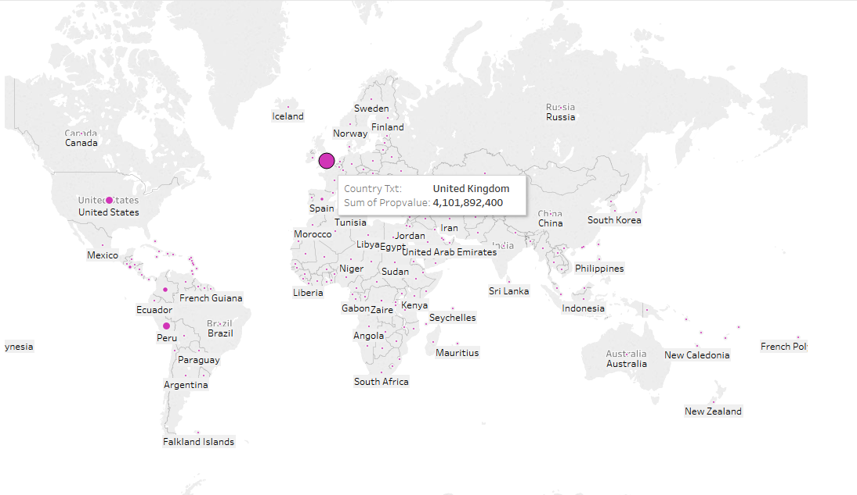
Terrorism related Property Value Damage (in USD)
‹#›

Slide 40

Number of people injured by the attack

Slide 41

Total number of people killed in the USA by various perpetrators

Slide 42

Number of people killed with no clear motive in globe/USA

Slide 43

Ransom amount based on Nationality

Slide 44


